Slide 1



Malaria in Africa
Collins Ononikpo
Last data refresh:
09/10/2021 16:36:29 UTC
Downloaded at:
09/10/2021 16:38:45 UTC

Slide 2
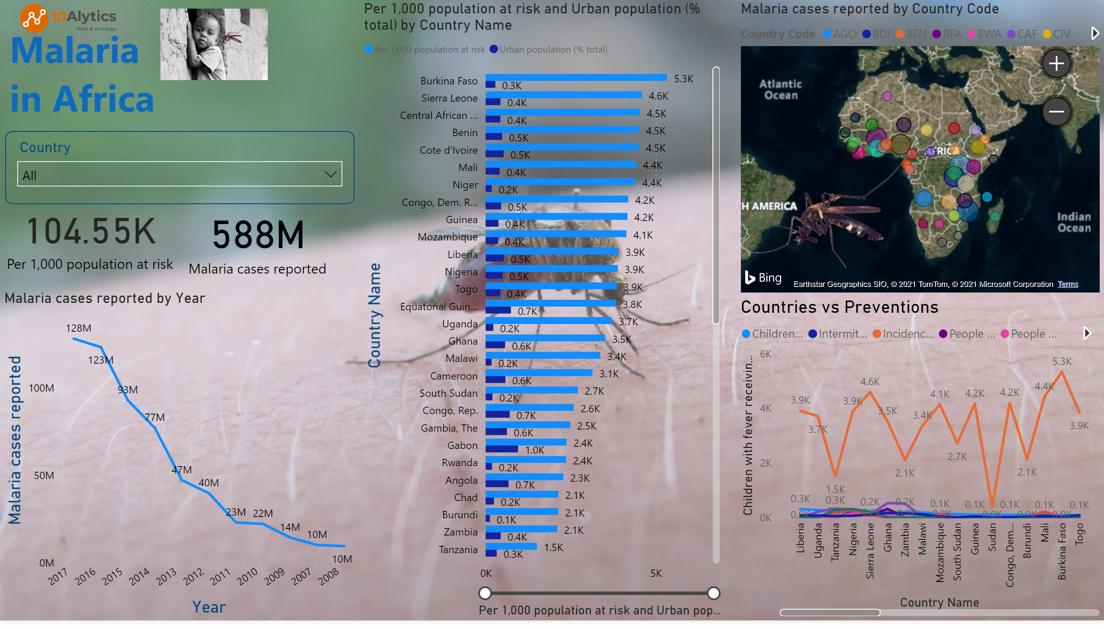
Page 1
Notes:
Malaria cases reported by Country Code
No alt text provided.
card
No alt text provided.
clusteredBarChart
No alt text provided.
lineChart
No alt text provided.
card
No alt text provided.
slicer
No alt text provided.
textbox
No alt text provided.
image
No alt text provided.
Countries vs Preventions
No alt text provided.
image
No alt text provided.
image
No alt text provided.
image
No alt text provided.

